Slide 1
switch case
switch (expression) {
case constant: statements
case constant: statements
default: statements
}
Use of break
Notes:
https://www.geeksforgeeks.org/interesting-facts-about-switch-statement-in-c/

Slide 2
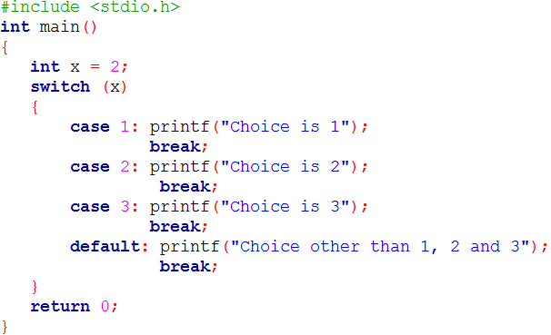
switch case
An Example
Notes:
https://www.geeksforgeeks.org/interesting-facts-about-switch-statement-in-c/

Slide 3
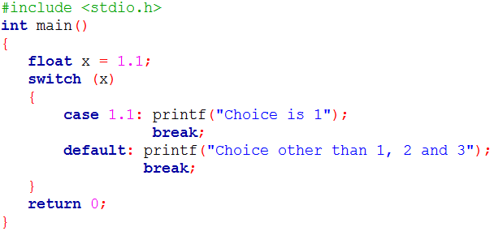
switch case properties
1. The expression used in switch must be integral type ( int, char and enum). Any other type of expression is not allowed.
Notes:
https://www.geeksforgeeks.org/interesting-facts-about-switch-statement-in-c/

Slide 4
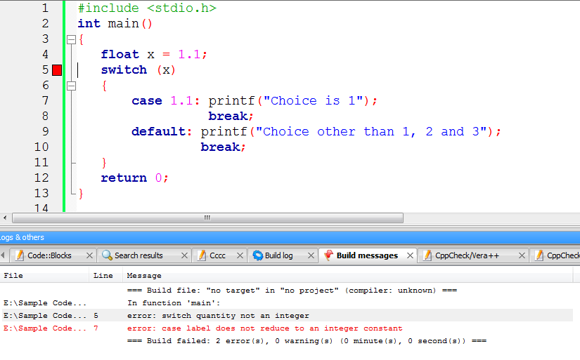
Output
Notes:
https://www.geeksforgeeks.org/interesting-facts-about-switch-statement-in-c/

Slide 5
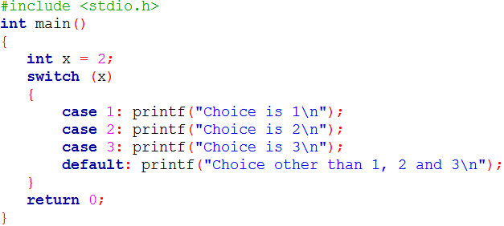
switch case properties
2. All the statements following a matching case execute until a break statement is reached.
Notes:
https://www.geeksforgeeks.org/interesting-facts-about-switch-statement-in-c/

Slide 6
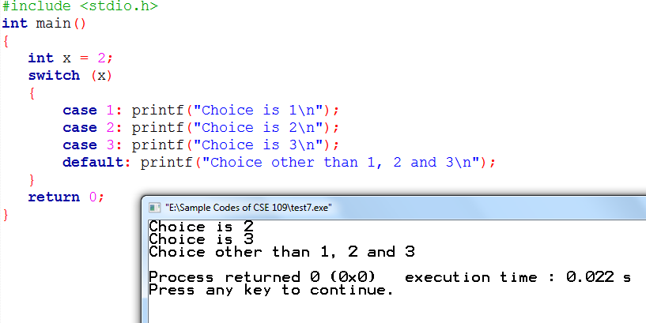
Output
Notes:
https://www.geeksforgeeks.org/interesting-facts-about-switch-statement-in-c/

Slide 7
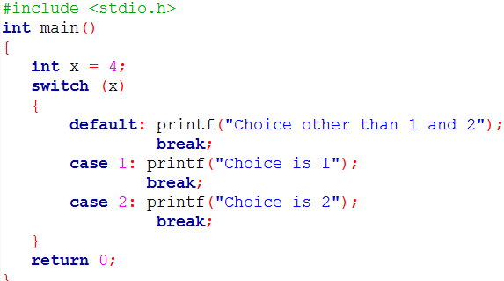
switch case properties
3. The default block can be placed anywhere. The position of default doesn’t matter, it is still executed if no match found.
Notes:
https://www.geeksforgeeks.org/interesting-facts-about-switch-statement-in-c/

Slide 8
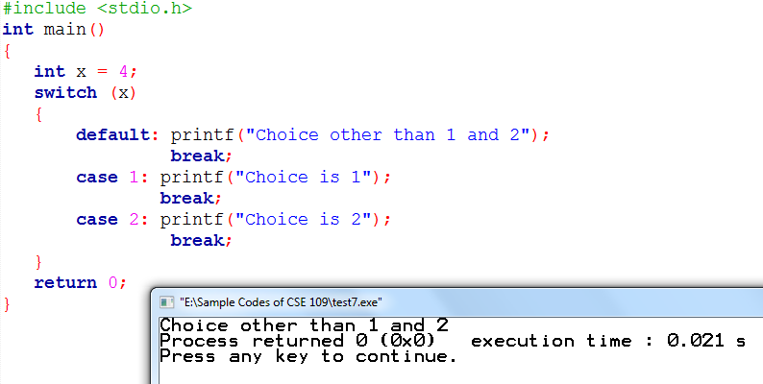
Output
Notes:
https://www.geeksforgeeks.org/interesting-facts-about-switch-statement-in-c/

Slide 9
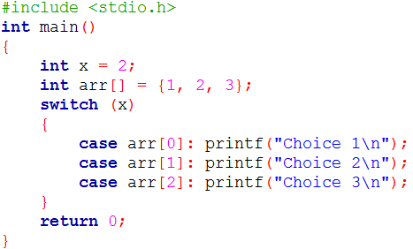
switch case properties
4. The integral expressions used in labels must be constant expressions.
Notes:
https://www.geeksforgeeks.org/interesting-facts-about-switch-statement-in-c/

Slide 10
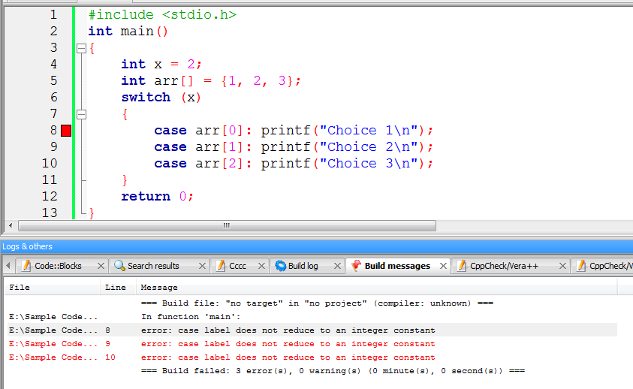
Output
Notes:
https://www.geeksforgeeks.org/interesting-facts-about-switch-statement-in-c/

Slide 11
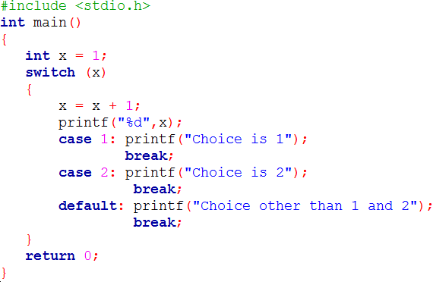
switch case properties
5. The statements written above/below cases are never executed. After the switch statement, the control transfers to the matching case, the statements written before/after case are not executed.
Notes:
https://www.geeksforgeeks.org/interesting-facts-about-switch-statement-in-c/

Slide 12
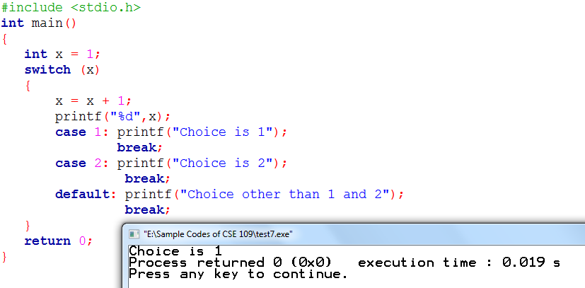
Output
Notes:
https://www.geeksforgeeks.org/interesting-facts-about-switch-statement-in-c/

Slide 13
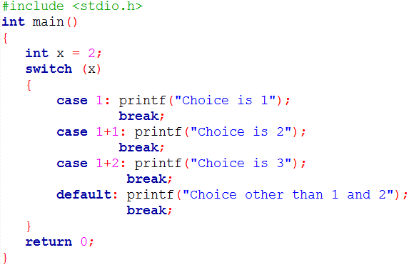
switch case properties
6. integral expressions used in labels can be an expression of constants.
Notes:
https://www.geeksforgeeks.org/interesting-facts-about-switch-statement-in-c/

Slide 14
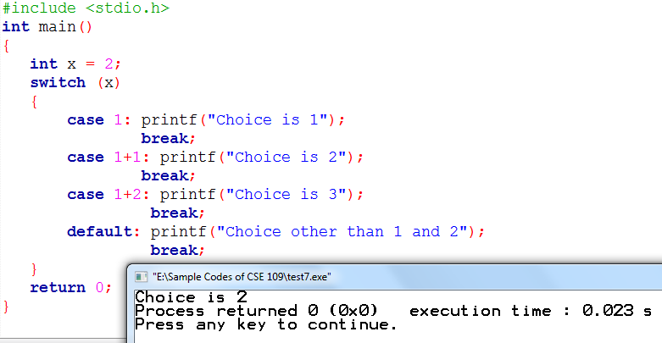
Output
Notes:
https://www.geeksforgeeks.org/interesting-facts-about-switch-statement-in-c/

Slide 15
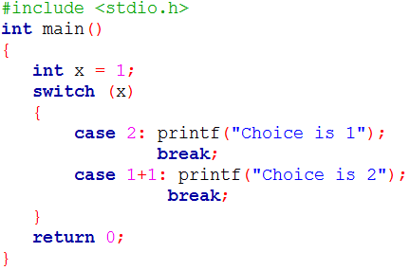
switch case properties
7. Two case labels cannot have same value.
Notes:
https://www.geeksforgeeks.org/interesting-facts-about-switch-statement-in-c/

Slide 16
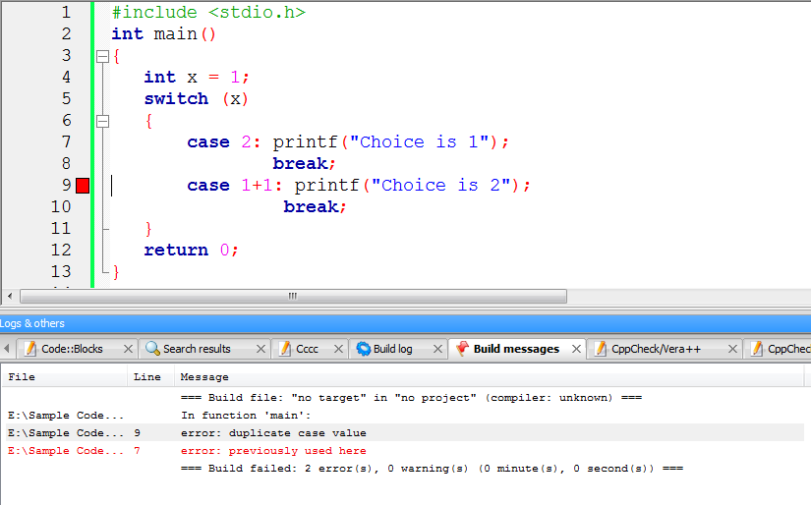
Output
Notes:
https://www.geeksforgeeks.org/interesting-facts-about-switch-statement-in-c/

Slide 17
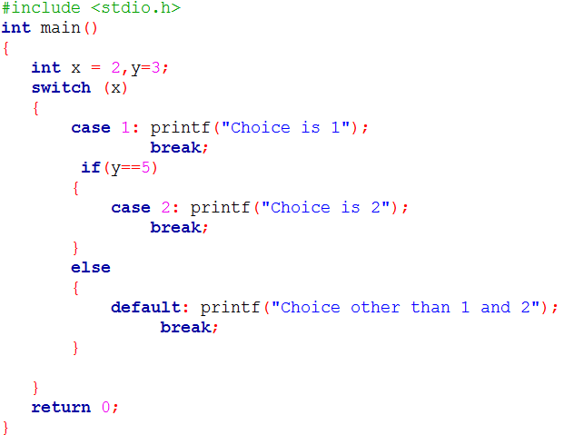
What is the output of the following code?
Notes:
https://www.geeksforgeeks.org/interesting-facts-about-switch-statement-in-c/

Slide 18
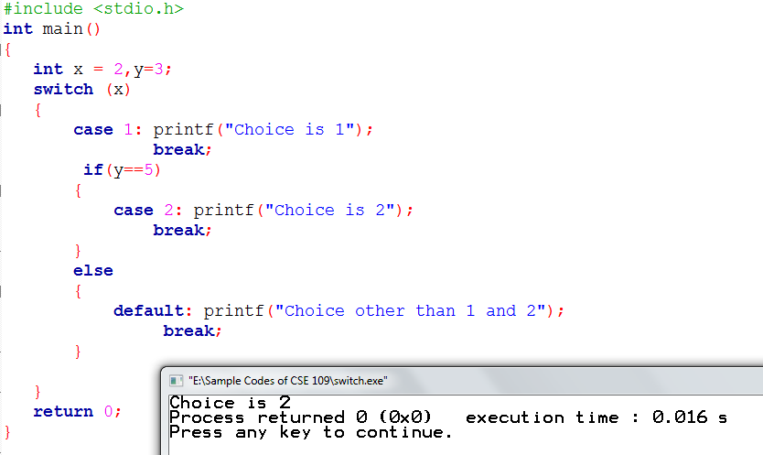
Output
Notes:
https://www.geeksforgeeks.org/interesting-facts-about-switch-statement-in-c/

Slide 19
for loop
Allows one or more statements to be repeated
for (initialization; conditional-test; increment) statement;
Most flexible loop

Slide 20
for loop
for (initialization; conditional-test; increment) statement;
initialization:
  Give an initial value to the variable that controls the loop
  loop-control variable
  Executed only once
  Before the loop begins

Slide 21
for loop
for (initialization; conditional-test; increment) statement;
conditional-test:
  Tests the loop-control variable against a target value
  If true the loop repeats
    statement is executed
  If false the loop stops
    Next line of code following the loop will be executed

Slide 22
for loop
for (initialization; conditional-test; increment) statement;
increment:
  Executed at the bottom of the loop

Slide 23
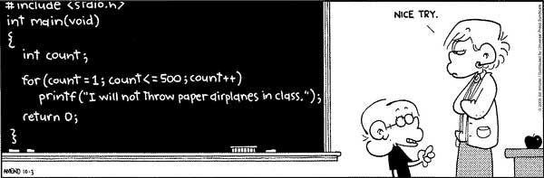
Programming Jokes!

Slide 24
for loop
for(i=1; i<3; i++)
printf("%d\n", i);
i is initialized to 1
Initialization part is executed only once

Slide 25
for loop
for(i=1; i<3; i++)
printf("%d\n", i);
Conditional test i<3 is true as i is 1, so the loop executes

Slide 26
for loop
for(i=1; i<3; i++)
printf("%d\n", i);
The value of i will be printed, which is 1

Slide 27
for loop
for(i=1; i<3; i++)
printf("%d\n", i);
The value of i will be incremented, so now i is 2.

Slide 28
for loop
for(i=1; i<3; i++)
printf("%d\n", i);
Conditional test i<3 is true as i is 2, so the loop executes

Slide 29
for loop
for(i=1; i<3; i++)
printf("%d\n", i);
The value of i will be printed, which is 2

Slide 30
for loop
for(i=1; i<3; i++)
printf("%d\n", i);
The value of i will be incremented, so now i is 3.

Slide 31
for loop
for(i=1; i<3; i++)
printf("%d\n", i);
Conditional test i<3 is false as i is 3, so the loop stops

